Slide 1
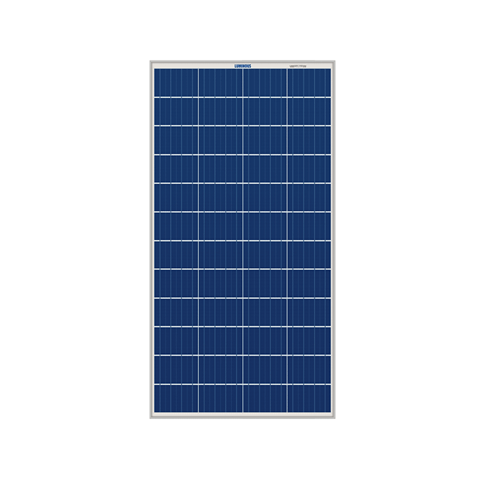
Monitoring Parameters – Topology - Hardware
Voltage Output, Current Output, Power Generation
Temperature, Light Intensity, Humidity, Fault Detection
Sensor Layer
Microcontroller Layer
Communication Layer
Cloud Server Layer
User Interface Layer
ESP32, Arduino Uno
Wireless
AWS – IOT core, lambda function, Data visualization
Solar Pannel
WEB, or APP

Slide 2
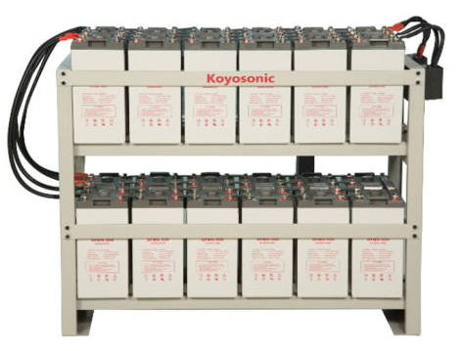
Monitoring Parameters – Topology - Hardware
Voltage, Current, Temperature, Battery Health, Charge/Discharge Cycles, Energy Input/Output, Fault Detection
Sensor Layer
BMS Layer
IoT Gateway Layer
Cloud Server Layer
User Interface Layer
SOC, SOH, DOD, SOP
Bridge between controller and Cloud
Stores data and runs analytics for insights
ESS
WEB, or APP

Slide 3
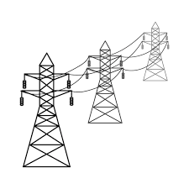
Monitoring Parameters – Topology - Hardware
Voltage, Current, Frequency, Power Factor, Harmonics, Load, Transformer Health, Fault Detection, Grid Stability, Renewable Energy Integration
Sensor Layer
Data Acquisition Layer
IoT Gateway Layer
Cloud Server Layer
User Interface Layer
PLC or RTU collects and processes data from sensors.
Wireless
AWS – IOT core, lambda function, Data visualization
Grid
WEB, or APP

Slide 4
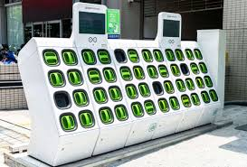
Monitoring Parameters – Topology - Hardware
State of Charge (SoC), Battery Voltage, Battery Current
Battery Temperature, Battery Health, Swapping Time, Fault Detection
Inventory Management, User Identification, Energy Usage
Sensor Layer
Processing Unit Layer
IoT Gateway Layer
Cloud Server Layer
User Interface Layer
Microcontroller or PLC processes data and manages the swapping process.
Bridge between controller and Cloud
Stores data and runs analytics for insights
Battery Swapping
WEB, or APP

Slide 5
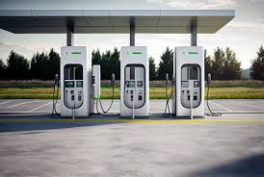
Monitoring Parameters – Topology - Hardware
Charging Status, Charging Power, Charging Time, Energy Delivered
Charging Efficiency, User Identification: Authenticates users, Fault Detection, Utilization Rate, Station Availability, Location Tracking
Sensor Layer
Data Acquisition Layer
IoT Gateway Layer
Cloud Server Layer
User Interface Layer
Charging station controller collects and processes sensor data.
Bridge between controller and Cloud
Stores data and runs analytics for insights
DC fast charging
WEB, or APP

Slide 6


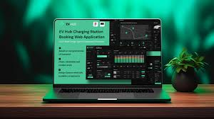
Monitoring Parameters – Topology - Hardware
Charging Status, Charging Power, Charging Time, Energy Delivered
Charging Efficiency, User Identification: Authenticates users, Fault Detection, Utilization Rate, Station Availability, Location Tracking
Device Layer
Data Ingestion Layer
Processing Layer
Cloud Server Layer
User Interface Layer
Charging station controller collects and processes sensor data.
Bridge between controller and Cloud
Stores data and runs analytics for insights
WEB, or APP
Cloud and user interface

Slide 7

User Interface Application Layer
IOT Architecture for Battery charging management
Application Layer
Presentation Layer
Session Layer
Transport Layer
Network Layer
Data Link Layer
Physical Layer
Cloud Server Layer Data storage
Communication Layer IoT Gateway Layer Processing Layer
Microcontroller Layer BMS Layer Data Acquisition Layer Processing Unit Layer
Sensor Layer

